Slide 1
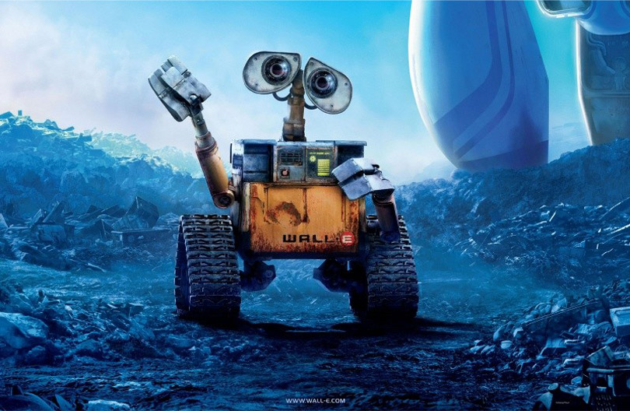
Rational Agents and Search (Chapters 2 & 3)
Notes:
<number>

Slide 2
Outline
Agent function and agent program
Rationality
PEAS (Performance measure, Environment, Actuators, Sensors)
Environment types
Agent types
Notes:
<number>

Slide 3
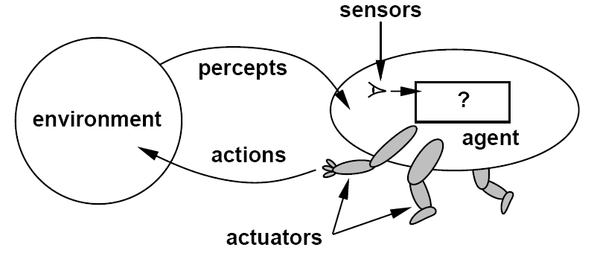
Agents
An agent is anything that can be viewed as perceiving its environment through sensors and acting upon that environment through actuators
Notes:
<number>

Slide 4
Agent function
The agent function maps from percept histories to actions
The agent program runs on the physical architecture to produce the agent function
agent = architecture + program
Notes:
<number>

Slide 5
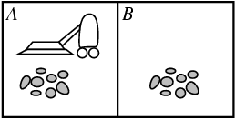
Vacuum-cleaner world
Percepts: Location and status, e.g., [A,Dirty]
Actions: Left, Right, Suck, NoOp
Example vacuum agent program:
function Vacuum-Agent([location,status]) returns an action
if status = Dirty then return Suck
else if location = A then return Right
else if location = B then return Left
Notes:
Scruffy versus neats
<number>

Slide 6
Rational agents
For each possible percept sequence, a rational agent should select an action that is expected to maximize its performance measure, given the evidence provided by the percept sequence and the agent’s built-in knowledge
Performance measure (utility function): An objective criterion for success of an agent's behavior
Can a rational agent make mistakes?
Notes:
ExpectedUtility(action) = sum_outcomes Utility(outcome) * P(outcome)
<number>

Slide 7
Back to vacuum-cleaner world
Percepts: Location and status, e.g., [A,Dirty]
Actions: Left, Right, Suck, NoOp
function Vacuum-Agent([location,status]) returns an action
if status = Dirty then return Suck
else if location = A then return Right
else if location = B then return Left
Is this agent rational?
Depends on performance measure, environment properties
Notes:
<number>

Slide 8
Specifying the task environment
Problem specification: Performance measure, Environment, Actuators, Sensors (PEAS)
Example: automated taxi driver
Performance measure
Safe, fast, legal, comfortable trip, maximize profits
Environment
Roads, other traffic, pedestrians, customers
Actuators
Steering wheel, accelerator, brake, signal, horn
Sensors
Cameras, sonar, speedometer, GPS, odometer, engine sensors, keyboard
Notes:
<number>

Slide 9
Agent: Spam filter
Performance measure
Minimizing false positives, false negatives
Environment
A user’s email account, email server
Actuators
Mark as spam, delete, etc.
Sensors
Incoming messages, other information about user’s account
Notes:
<number>

Slide 10
Environment types
Fully observable (vs. partially observable): The agent's sensors give it access to the complete (vs. partial) state of the environment at each point in time
Deterministic (vs. stochastic): The next state of the environment is completely (vs. probabilistically) determined by the current state and the agent’s action
Strategic: the environment is deterministic except for the actions of other agents
Episodic (vs. sequential): The agent's experience is divided into atomic “episodes,” and the choice of action in each episode does not affect future decisions (vs. could affect future decisions)
Notes:
<number>

Slide 11
Environment types
Static (vs. dynamic): The environment is unchanged while an agent is deliberating
Semidynamic: the environment does not change with the passage of time, but the agent's performance score does
Discrete (vs. continuous): The environment provides a fixed number of distinct percepts, actions, and environment states
Time can also evolve in a discrete or continuous fashion
Single agent (vs. multi-agent): An agent operating by itself in an environment
Known (vs. unknown): The agent knows the rules (laws of physics) of the environment
Notes:
<number>

Slide 12
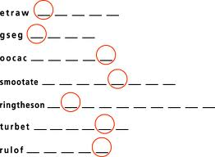
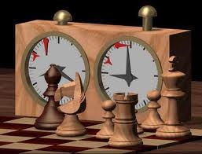
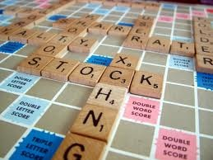
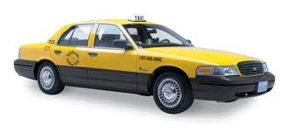
Examples of different environments
Word jumble solver
Chess with a clock
Scrabble
Taxi driving
Fully
Fully
Partially
Partially
Observable
Deterministic
Episodic
Static
Discrete
Single agent
Deterministic
Strategic
Stochastic
Stochastic
Episodic
Sequential
Sequential
Sequential
Static
Semidynamic
Static
Dynamic
Discrete
Discrete
Discrete
Continuous
Single
Multi
Multi
Multi
Notes:
<number>

Slide 13
Hierarchy of agent types
Simple reflex agents
Model-based reflex agents
Goal-based agents
Utility-based agents
Notes:
<number>

Slide 14
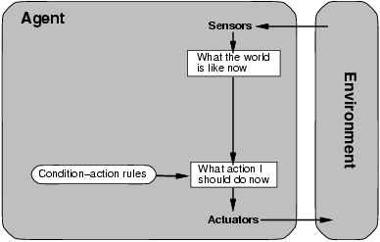
Simple reflex agent
Select action on the basis of current percept, ignoring all past percepts
Notes:
<number>

Slide 15
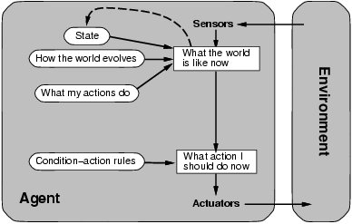
Model-based reflex agent
Maintains internal state that keeps track of aspects of the environment that cannot be currently observed
Notes:
<number>

Slide 16
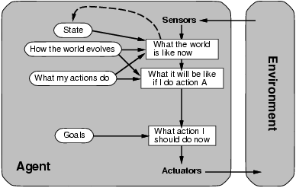
Goal-based agent
The agent uses goal information to select between possible actions in the current state
Notes:
<number>

Slide 17
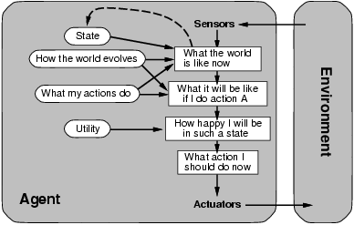
Utility-based agent
The agent uses a utility function to evaluate the desirability of states that could result from each possible action
Notes:
<number>

Slide 18
Where does learning come in?
Notes:
<number>

Slide 19
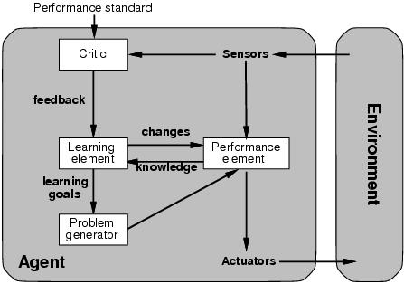
Where does learning come in?
Notes:
<number>

Slide 20
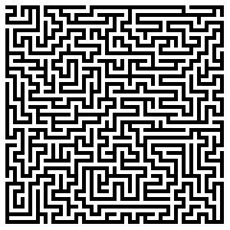
Solving problems by searching
Chapter 3
Notes:
<number>

Slide 21

Search
We will consider the problem of designing goal-based agents in fully observable, deterministic, discrete environments
Example:
Start state
Goal state
Notes:
<number>

Slide 22
Search
We will consider the problem of designing goal-based agents in fully observable, deterministic, discrete environments
The solution is a fixed sequence of actions
Search is the process of looking for the sequence of actions that reaches the goal
Once the agent begins executing the search solution, it can ignore its percepts (open-loop system)
Notes:
<number>

Slide 23
Search problem components
Initial state
Actions
Transition model
What is the result of performing a given action in a given state?
Goal state
Path cost
Assume that it is a sum of nonnegative step costs
The optimal solution is the sequence of actions that gives the lowest path cost for reaching the goal
Initial
state
Goal state
Notes:
<number>

Slide 24
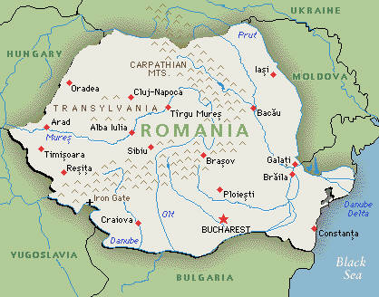
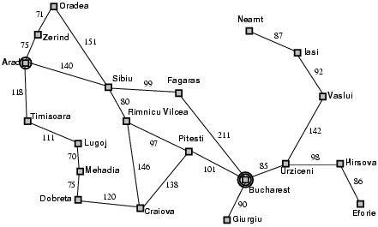
Example: Romania
On vacation in Romania; currently in Arad
Flight leaves tomorrow from Bucharest
Initial state
Arad
Actions
Go from one city to another
Transition model
If you go from city A to city B, you end up in city B
Goal state
Bucharest
Path cost
Sum of edge costs
Notes:
<number>

Slide 25
State space
The initial state, actions, and transition model define the state space of the problem
The set of all states reachable from initial state by any sequence of actions
Can be represented as a directed graph where the nodes are states and links between nodes are actions
What is the state space for the Romania problem?
Notes:
<number>

Slide 26
Example: Vacuum world
States
Agent location and dirt location
How many possible states?
What if there are n possible locations?
Actions
Left, right, suck
Transition model
Notes:
<number>

Slide 27
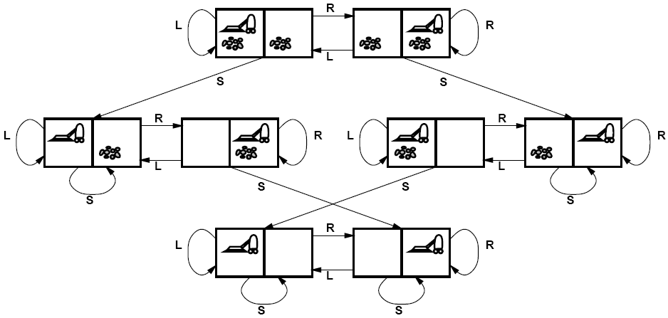
Vacuum world state space graph
Notes:
<number>

Slide 28
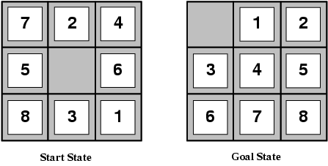
Example: The 8-puzzle
States
Locations of tiles
8-puzzle: 181,440 states
15-puzzle: 1.3 trillion states
24-puzzle: 10²⁵ states
Actions
Move blank left, right, up, down
Path cost
1 per move
Finding the optimal solution of n-Puzzle is NP-hard
Notes:
<number>

Slide 29
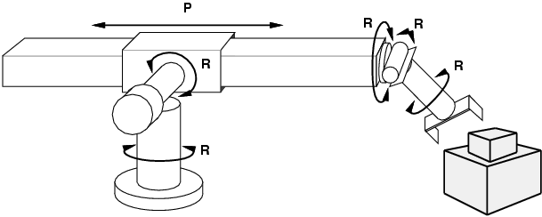
Example: Robot motion planning
States
Real-valued coordinates of robot joint angles
Actions
Continuous motions of robot joints
Goal state
Desired final configuration (e.g., object is grasped)
Path cost
Time to execute, smoothness of path, etc.
Notes:
<number>

Slide 30
Search
Given:
Initial state
Actions
Transition model
Goal state
Path cost
How do we find the optimal solution?
How about building the state space and then using Dijkstra’s shortest path algorithm?
The state space may be huge!
Complexity of Dijkstra’s is O(E + V log V), where V is the size of the state space
Notes:
<number>

Slide 31
Tree Search
Let’s begin at the start node and expand it by making a list of all possible successor states
Maintain a fringe or a list of unexpanded states
At each step, pick a state from the fringe to expand
Keep going until you reach the goal state
Try to expand as few states as possible
Notes:
<number>

Slide 32
Search tree
Starting state
“What if” tree of possible actions and outcomes
The root node corresponds to the starting state
The children of a node correspond to the successor states of that node’s state
A path through the tree corresponds to a sequence of actions
A solution is a path ending in the goal state
Nodes vs. states
A state is a representation of a physical configuration, while a node is a data structure that is part of the search tree
Action
Successor state
…
…
…
…
Goal state
Notes:
<number>

Slide 33
Tree Search Algorithm Outline
Initialize the fringe using the starting state
While the fringe is not empty
Choose a fringe node to expand according to search strategy
If the node contains the goal state, return solution
Else expand the node and add its children to the fringe
Notes:
<number>

Slide 34
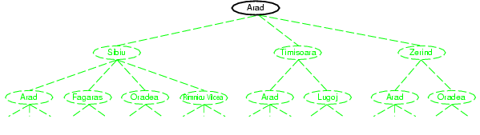
Tree search example
Notes:
<number>

Slide 35
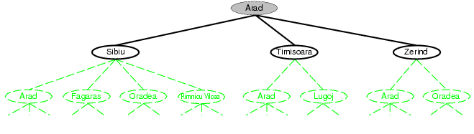
Tree search example
Notes:
<number>

Slide 36
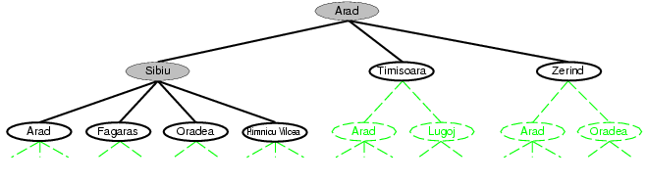
Tree search example
Fringe
Notes:
<number>

Slide 37
Search strategies
A search strategy is defined by picking the order of node expansion
Strategies are evaluated along the following dimensions:
Completeness: does it always find a solution if one exists?
Optimality: does it always find a least-cost solution?
Time complexity: number of nodes generated
Space complexity: maximum number of nodes in memory
Time and space complexity are measured in terms of
b: maximum branching factor of the search tree
d: depth of the least-cost solution
m: maximum length of any path in the state space (may be infinite)
Notes:
<number>

Slide 38
Uninformed search strategies
Uninformed search strategies use only the information available in the problem definition
Breadth-first search
Uniform-cost search
Depth-first search
Iterative deepening search
Notes:
<number>

